Slide 1
Image colorisation using GAN
By: Nehal murdeshwar – 210962021
Abhiram Reddy Konda – 210962003

Slide 2
Problem Statement
Successfully colorize black and white images to achieve a realistic appearance compared to the original.

Slide 3
Dataset used
We used the COCO dataset, which is the Common Objects in Context dataset widely used in multiple computer vision tasks such as object detection, segmentation, and image captioning.
Ideal choice for deep learning models as it exposes the model to a wide range of textures, contexts and colour patterns.

Slide 4
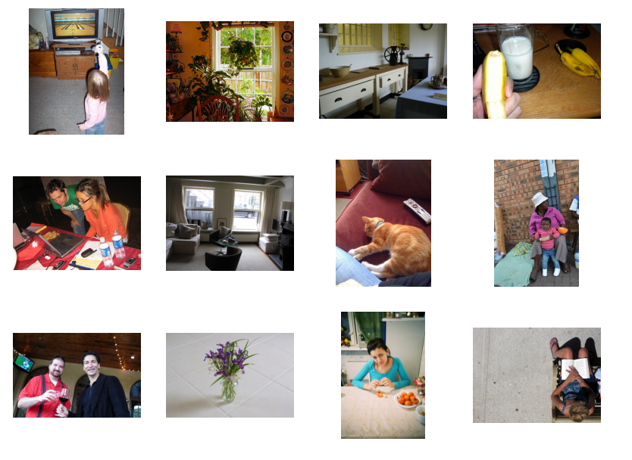
Few examples of images in the dataset

Slide 5
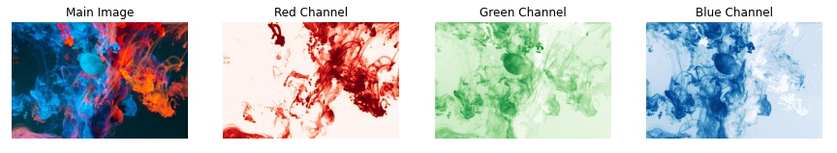
RGB vs L*a*B* color space
RGB -> (0 to 255 range of RED, GREEN and BLUE)

Slide 6
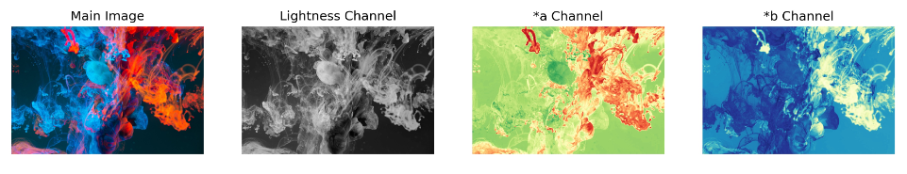
RGB vs L*a*B* color space
L*a*b* -> (Lightness, green-red, yellow-blue)
Lightness range from 0 to 100(appears as black and white
a* range from -128 to +127 (measures how green-red a pixel is)
b* range from -128 to +127(measures how yellow-blue a pixel is)

Slide 7
Why L*a*B* over RGB?
To train a model for colorisation, we need to feed a grayscale image as input.
In L*a*b*, we can feed the L channel to the model and make it predict the other 2 channels(a* and b*).
Concatenate all the channels after its prediction and we get our output image.
However, when using RGB, we have to convert it to grayscale and ask it to predict 3 numbers instead of 2 which adds to the instability and difficulty of the task as there are a lot more combinations of 3 numbers compared to 2 numbers.

Slide 8
General concept behind the project
We use a GAN model with an extra loss function, L1 Loss.
In GAN we have a generator and discriminator model which learn to solve a problem together.
The generator takes in a grayscale image and produces a 2- channel image,(a* and b*).
The discriminator takes these 2 produced channels and concatenates them with the input grayscale image and decides whether this new 3-channel image is fake or real.
Discriminator needs to see some real images that are not produced by the generator and learn that they are real.

Slide 9
STEPWISE Structure of the project
Data Preparation
Building the Generator(U-Net)
Building the Discriminator
GAN Loss
Training the model
Evaluation of the model

Slide 10
Data preparation
We download 20,000 images from the COCO dataset and randomly pick 10,000
Training set includes 8000 images and validation set includes 2000 images.
We resize all images to a consistent dimension of 256x256 using bicubic interpolation.
Horizontal flip augmentation is applied to the training set images.
Conversion of image in RGB space to L*a*b* color space.

Slide 11
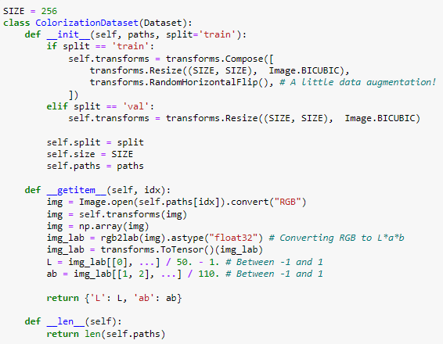
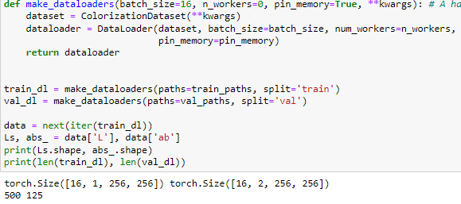
DATA preparation

Slide 12
Building the generator(u-net)
U-Net uses a CNN as an encoder – decoder architecture to colorise gray-scale images.
Encoding part converts input image to a compact representation.
Decoding part reconstructs the input image.
Bridge connects the encoding and decoding units.

Slide 13
Building the generator(U-net)
U-Net we use goes 8 layers down.
Start with a 256x256 image which becomes a 1x1 image after down-sampling
Up-sampling it back to a 256x256 image with 2 channels instead of 1.
Down-sampling consists of LeakyReLU , Conv2d and BatchNorm2d.
Up-sampling consists of ReLU, ConvTranspose2d and BatchNorm2d.
Addition of a Dropout layer sometimes to prevent overfitting.
TanH used over ReLU as the activation function in the outermost later as the output can be directly compared with the input image during training.
All the layers except the outermost layers, the up-sampling path concatenates the up-sampled features with the corresponding down-sampled features via skip connections in order to preserve spatial information that is lost.

Slide 14
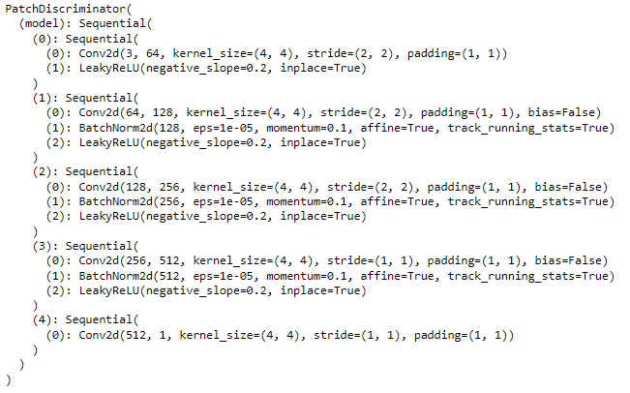
Building the discriminator
Architecture is straight-forward.
Blocks of Conv2d - BatchNorm2d - LeakyReLU to decide if the input image is fake or real.

Slide 15
Why patchdiscriminator
In a vanilla discriminator, model outputs 1 number which represents how much the model thinks the input(whole image) is real or fake.
In a patch discriminator, model outputs 1 number for every patch of a certain size NxN of the input image and for each of them decides whether it is fake or not separately.
This is important as the local changes the model needs to make are important and deciding on the whole image at once cannot take care of the subtleties of this task.

Slide 16
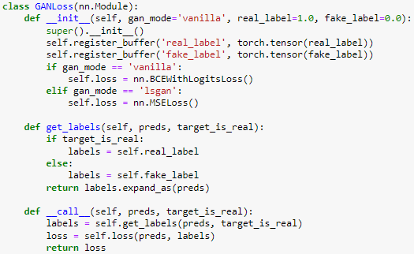
GAN LOSS
We use vanilla loss in our project as specified in the gan_mode part of the code.
Register some constant tensors as the real and fake labels.
We then call this module which makes an appropriate tensor full of zeros or ones and computes the loss.

Slide 17
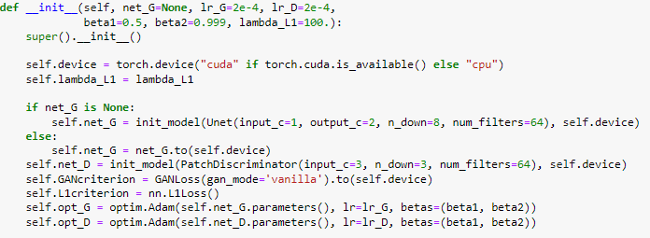
Training the model
We define our generator and discriminator using the classes and functions we defined previously.
We also define our 2 loss functions and the optimisers of the generator and discriminator.

Slide 18
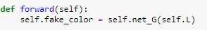
Training the model
First and only once per iteration(batch of training set), we call the forward method and store the outputs in fake_color variable of the class.

Slide 19
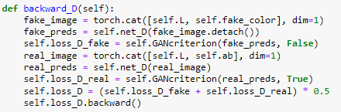
Training the model
We train the discriminator using backward_D method in which we feed the fake images produced by the generator to the discriminator and label tham as fake.
Then we feed a batch of real images from the training set to the discriminator and label them as real.
We add up the two losses for fake and real and take the average, then call the backward on the final loss.

Slide 20
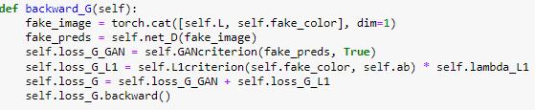
Training the model
Now, we can train the generator. We feed the discriminator the fake image and try to fool it by assigning real labels to them and calculating the adversarial loss.
We use L1 loss as well and compute the distance between the predicted 2 channels and the targeted 2 channels and multiple this loss by a coefficient(100) to balance the 2 losses and add this lossto the adversarial loss.

Slide 21
Result
We trained the model for 175 epochs.
Each epoch has 500 iterations with visualisation of intermediate results occurring every 250 iterations.
1 epoch took around 6 minutes to run and hence the total training time was in excess of 17 hours.

Slide 22
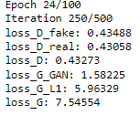
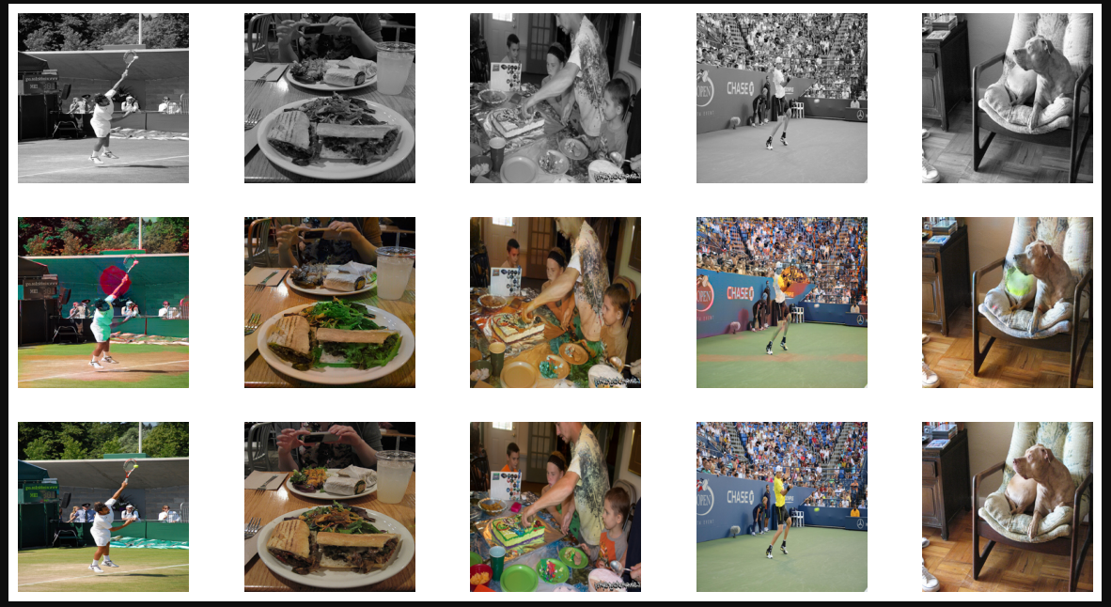
Example of intermediate visualisation

Slide 23
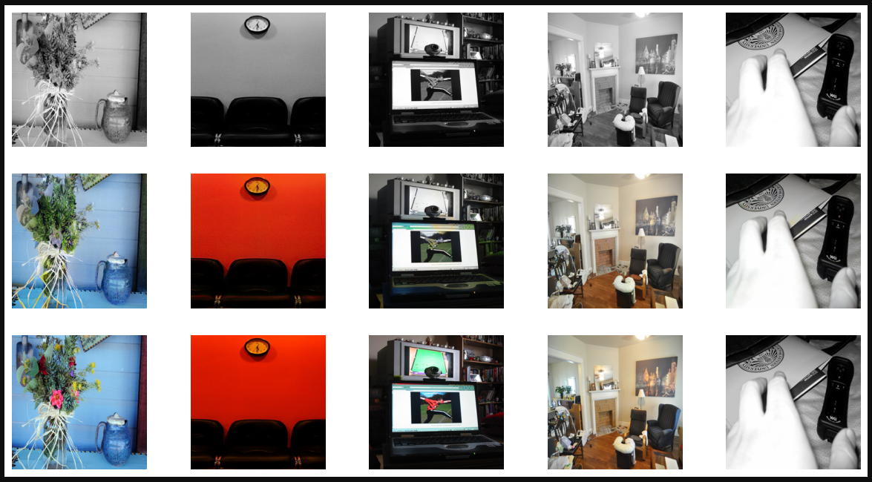
Final result after 175 epochs
Input Image
Predicted Image
Target Image

Slide 24
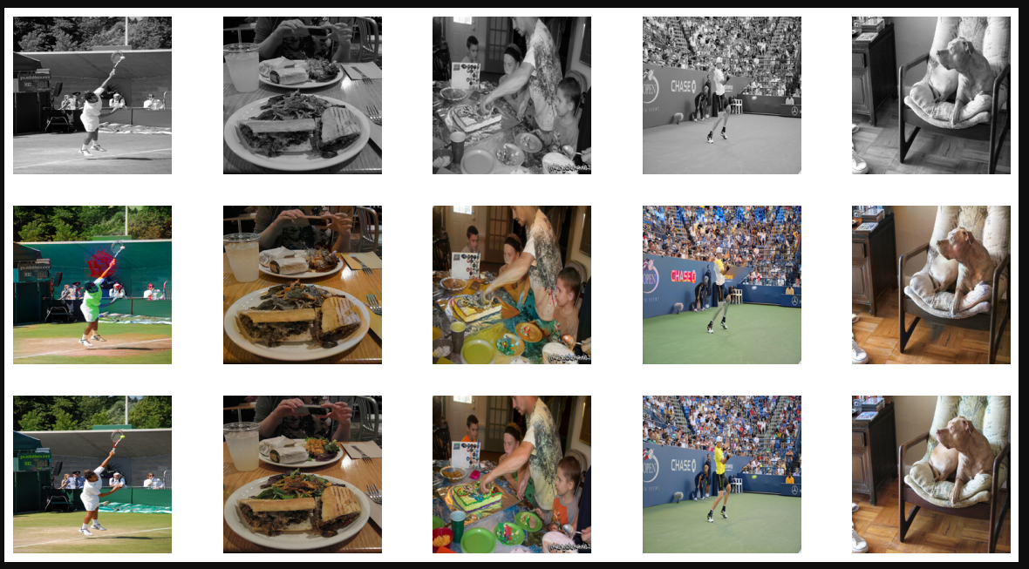
Final result after 175 epochs
Input Image
Predicted Image
Target Image

Slide 25
Conclusion
While the model demonstrates good understanding of common objects typically found in images, it falls shot of delivering visually appealing results.
Upon closer inspection, several deficiencies become apparent.
Performance falters when tasked with colouring less prevalent elements as compared to common ones.
Future-work might involve using a pre-trained model such as Res-Net as the generator given its state of the art quality in image segmentation, colourisation tasks.

Slide 26

Thank YOu

